Slide 1

Optimization methods in R.
Alexey Osipov.

Slide 2

Methods from optim.
Nelder-Mead (default, only function values, slow).
BFGS (quasi-Newton, gradients)
CG (more fragile, better for larger optimization problems)
L-BFGS-B (box constraints)
SANN (global optimization)
Brent (one-dimensional problems)

Slide 3

Nelder-Mead.
Simplex with n+1 points in dimensions and its modifications.
Calculate centroid.
Calculate reflected point.
Either reflection, expansion, or contraction.
Shrink.
Only function values are used.

Slide 4

BFGS method.
Hessian is approximated.
Quasi-Newton method (Hessian is modified, but not updated from scratch).
The secant equation.
The curvature condition.
Line search for finding the new point.

Slide 5
Nonlinear conjugate gradient method.
It is recommended to be used for large problems.
Vectors that are conjugate to a matrix.
Search direction.
Displacement vector.
Update the estimate.

Slide 6
L-BFGS-B
Recent iterations are used to compute Hessian.
Supports box constraints.
Current iterate, function, gradient, limited memory Hessian proxy.
Quadratic problem with constraints.
Backtracking line search.
New approximation of Hessian.

Slide 7
Simulated annealing.
Global optimum.
Good for discrete search space.
The next state is chosen as a random neighbor.
The temperature matters. It decreases with time.
Transition and acceptance probabilities.

Slide 8
Brent’s method.
One-dimensional case only.
Combination of bisection and secant methods.
Current iterate, contrapoint, previous iterate.
The method’s choice also depends on the previous choice.
Modified secant (inverse quadratic interpolation).

Slide 9

quadprog::solve.QP
Quadratic problem with linear constraints.
Dual method of Goldfarb and Idnani.
Unconstrained problem is easy.
We try to fix the violated constraints.

Slide 10
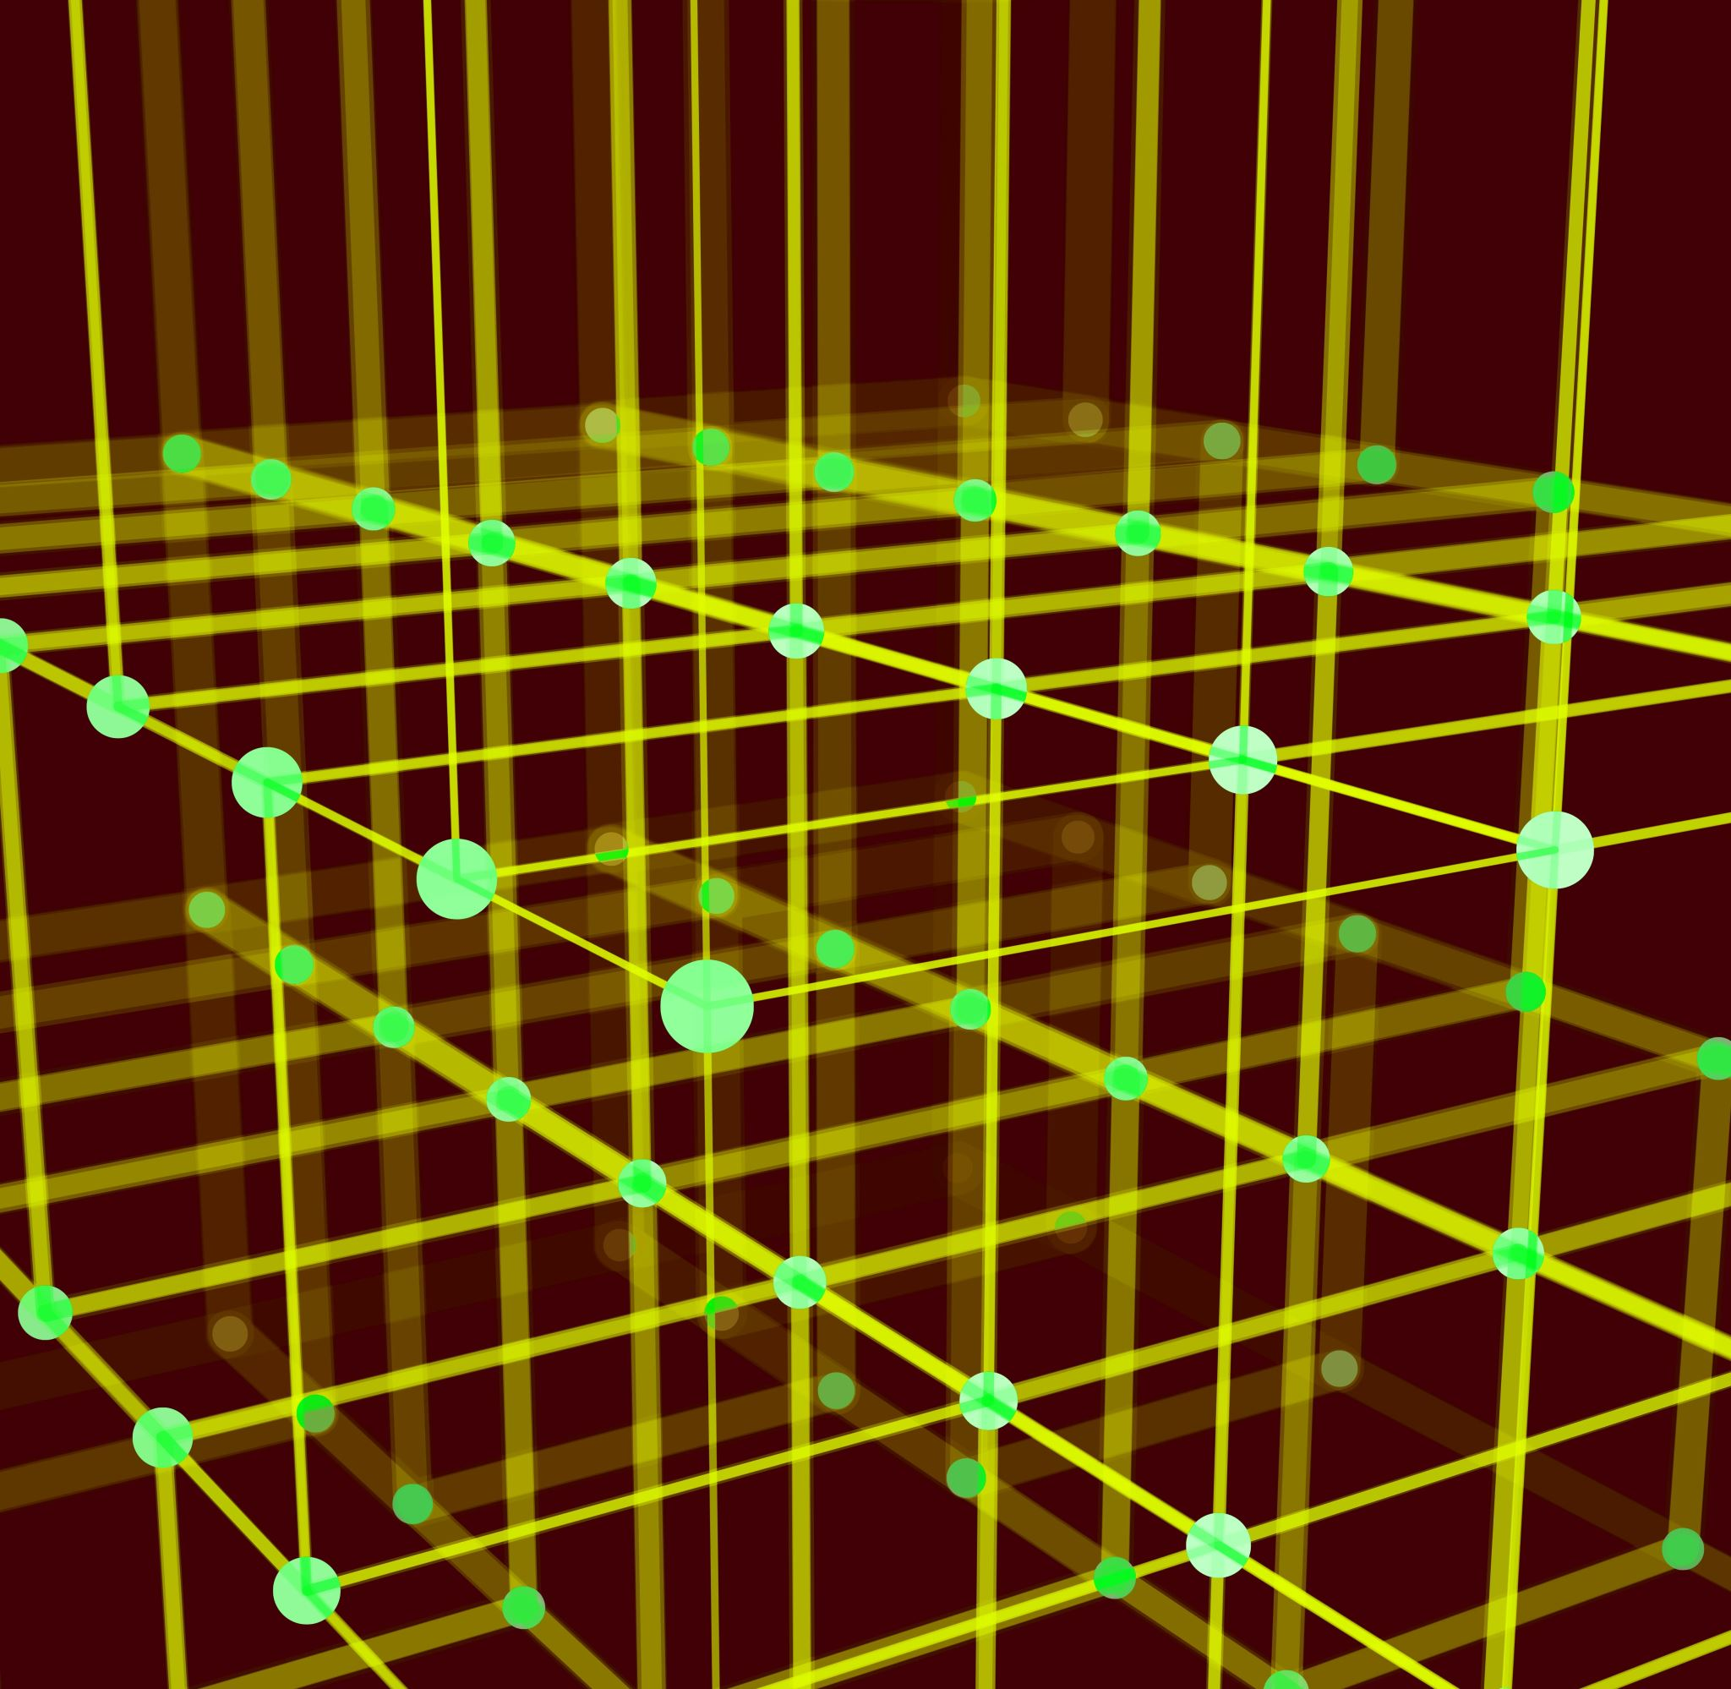
linprog:solveLP
Linear function, linear constraints.
The Simplex algorithm.
Choice of the best extreme point.
Moving around the simplex.

Slide 11

nloptr
Nlopt: NLopt algorithms - NLopt Documentation
Nonlinear function, nonlinear constraints.
Global optimization (8 algorithms)
Local optimization (6 algorithms)
Local gradient based optimization (7 algorithms)

